Slide 1
SALT 2.5 Bias Network
Akademia Górniczo-Hutnicza im. Stanisława Staszica w Krakowie
AGH University of Science and Technology
Tomasz Fiutowski

Slide 2
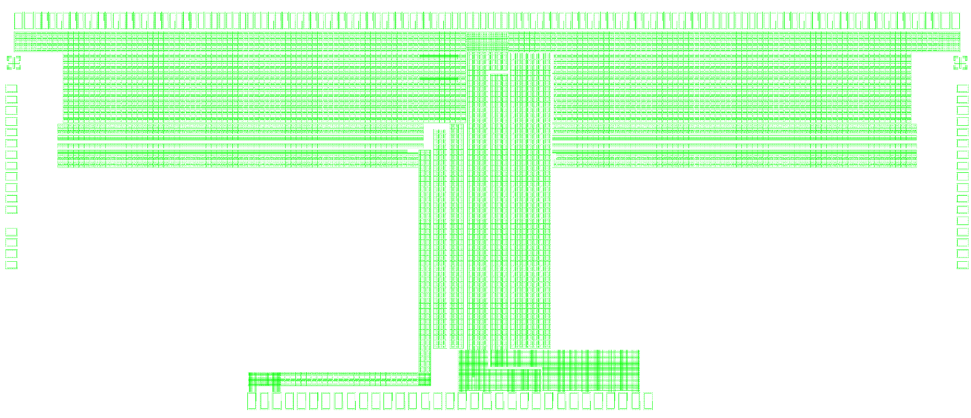
METAL 7 distribution
10704µm
4560µm
4060µm
4130µm
2540µm
Next slide
3370µm
3130µm
3350µm
2520µm
1700µm
2070µm
R_MET7=5.5mΩ/□

Slide 3
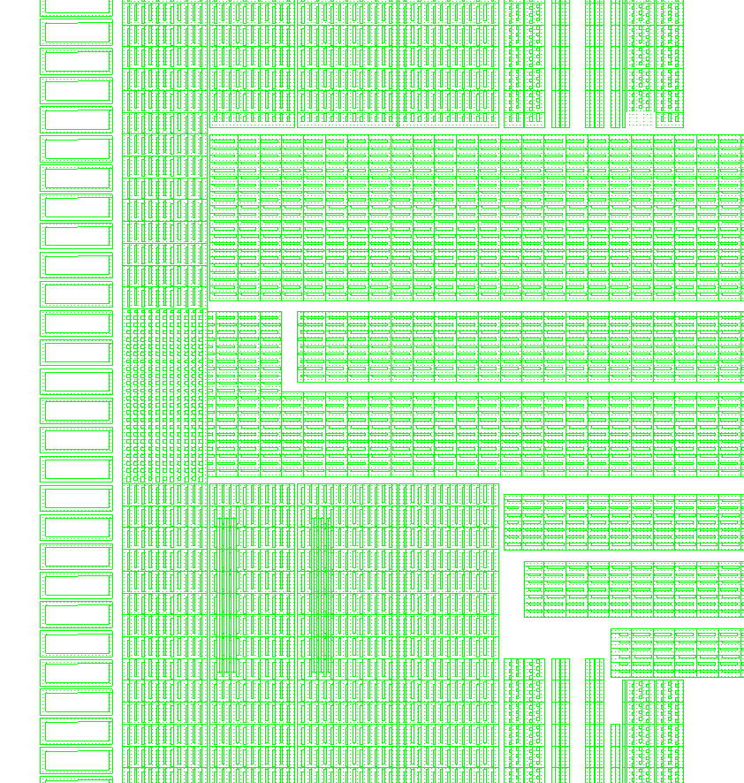
METAL 7 distribution
12x14µm
14x14µm
VDDADC(S2D)&VSSADC(S2D) 3x14µm
12x14µm
14x14µm
VDDADC&VSSADC 4x14µm
23x14µm
VDDA
10x14µm
VSSA
VSSA_PRE
Effective rail widths (without 6µm slots)
12x14µm
VSSA_PRE
VDDADC
8x14µm
VSSADC
VDDA
VSSA
VDDA
VREFD
VDDADC(S2D)
VSSADC(S2D)
VDDADC
VDDADC
VSSADC
VSSADC
VREFD
VSSADC
VDDADC
VREFD&VDDADC&VSSADC 23µm

Slide 4
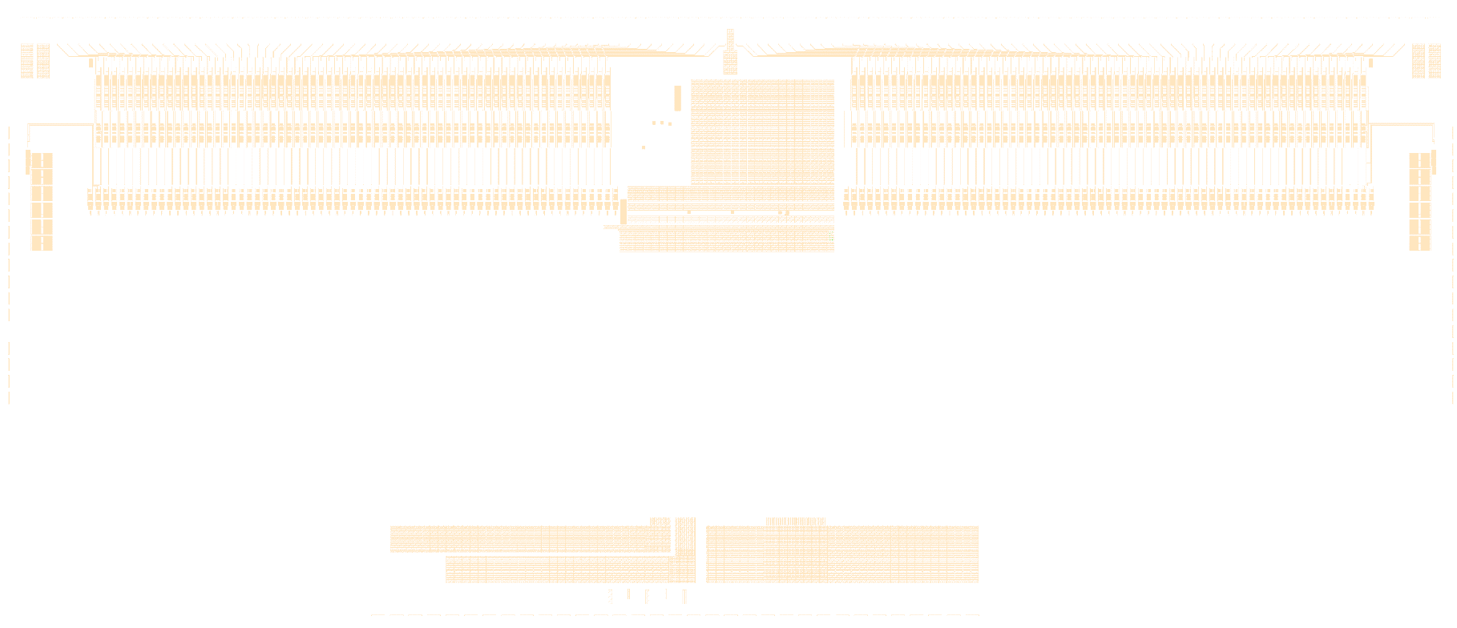
METAL 6 distribution
2054µm
2054µm
Next slide
200µm
430µm
VSSADC
2110µm
2054µm
VDDADC
1875µm
VDDA
R_MET6=25mΩ/□

Slide 5
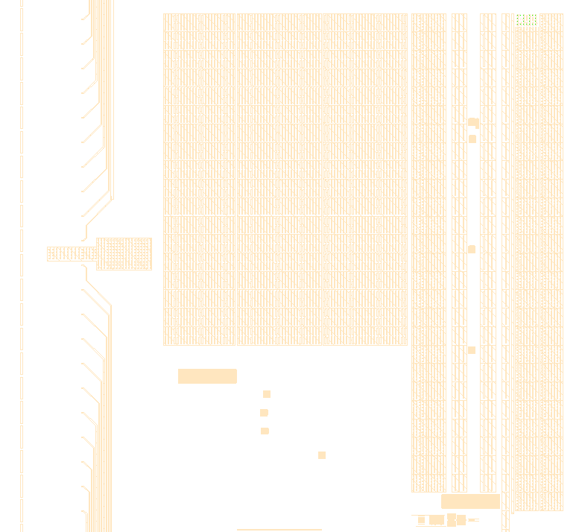
METAL 6 distribution
234µm
274µm
274µm
VDDA
VSSA
VDDA

Slide 6
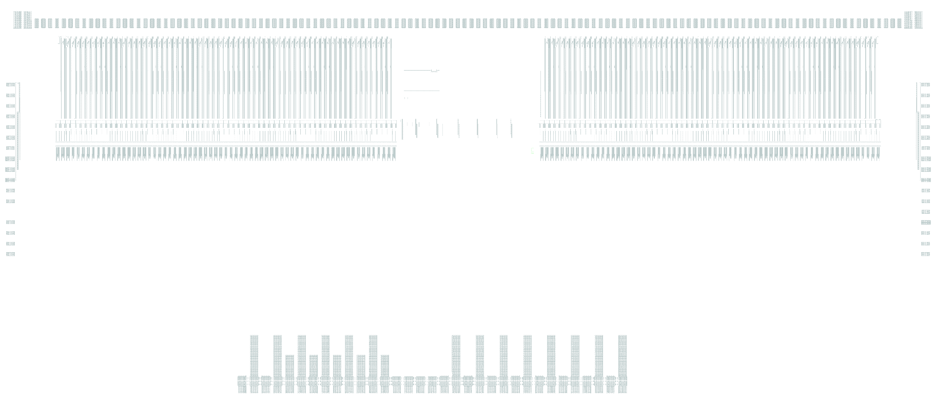
METAL 5 distribution
R_MET5=60mΩ/□

Slide 7
Padring

