Slide 1
Multielectrode neural interfaces – technology and applications
Paweł Hottowy
Władysław Dąbrowski - AGH University of Science and Technology
Alan M. Litke - University of California, Santa Cruz
Keith Mathieson - University of Glasgow
E. J. Chichilnisky - Salk Institute for Biological Studies
John M. Beggs - University of Indiana

Slide 2
Introduction
512-electrode system for recording of neural activity in-vitro
Application 1: visual information processing in the retina
Application 2: information processing in the brain
Simultaneous stimulation and recording of neural activity in-vitro
Wireless recording of brain activity in freely behaving animals
Plans

Slide 3
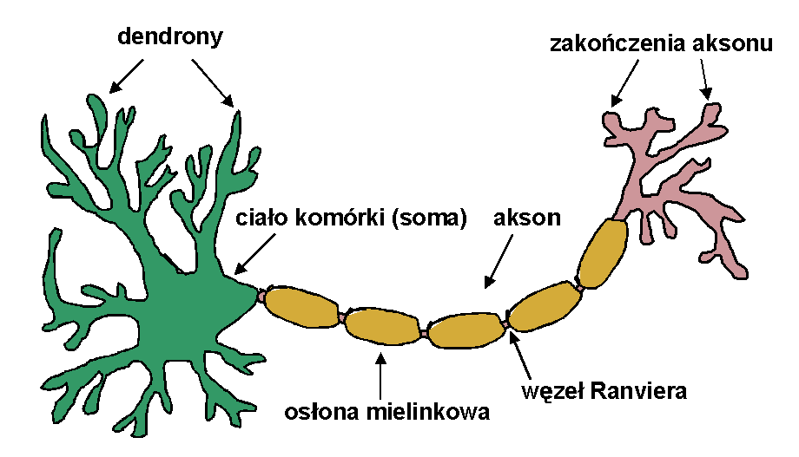
Introduction

Slide 4
Introduction
dendrites

Slide 5
Introduction
dendrites
cell body

Slide 6
Introduction
dendrites
cell body
axon

Slide 7
Introduction
intracellular recording

Slide 8
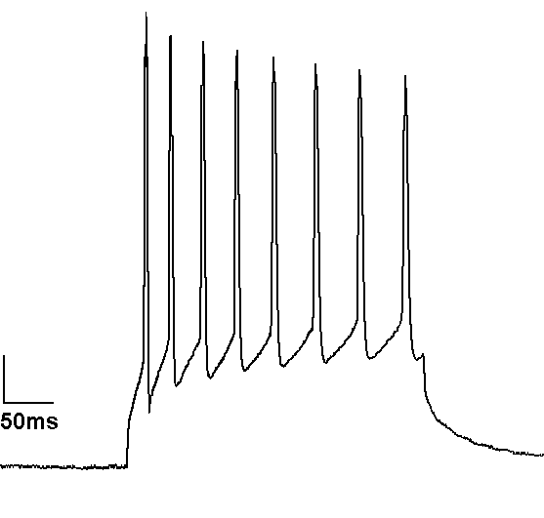
Introduction
signal amplitude ~100 mV
10 mV
50 ms
intracellular recording

Slide 9
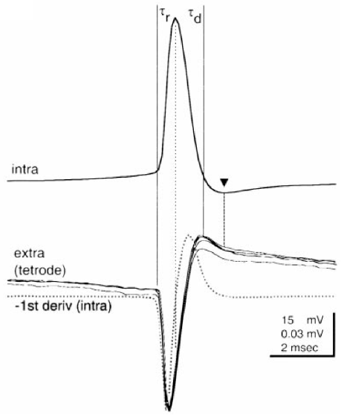
Introduction
signal amplitude: 50-500 μV
200μV
2 ms
extracellular recording

Slide 10
Introduction
signal amplitude: 50-500 μV
200μV
2 ms

Slide 11
Introduction
First Multi-Electrode Array (MEA)
Thomas CA, et al: A miniature microelectrode array to monitor the bioelectric activity of cultured cells. Exp. Cell Res., 1972.
Standard of the 90s:
- 60 electrodes
- spatial resolution: 100 μm

Slide 12
512-electrode system

Slide 13
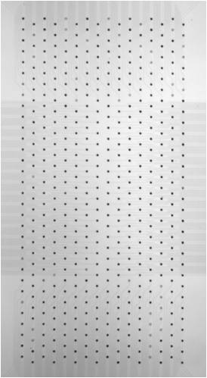
512-electrode system
0.9 mm
1.86 mm
Mathieson K, et al: Large-area microelectrode arrays for recording of neural signals. IEEE Trans Nuc Sci, 2004.

Slide 14
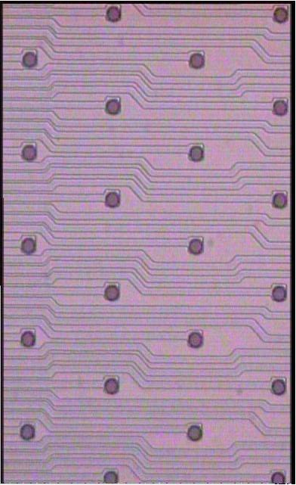
512-electrode system
512 electrodes
0.9 mm
5 μm diameter
60 μm
1.86 mm
Mathieson K, et al: Large-area microelectrode arrays for recording of neural signals. IEEE Trans Nuc Sci, 2004.

Slide 15
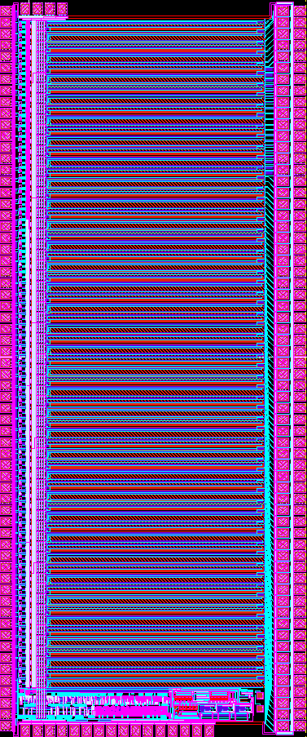
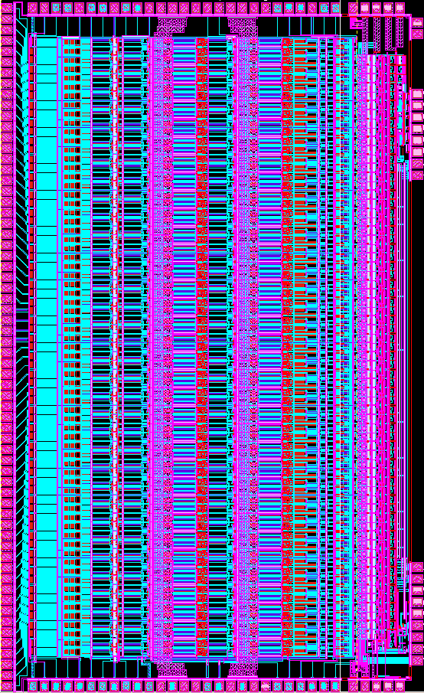
512-electrode system
conenctions to 64
electrodes
PC
4,8 mm
Dąbrowski W, et al: A low-noise multichannel integrated circuit for recording neuronal signals using microelectrode arrays. Biosensors & Bioelectronics, 2004.

Slide 16
512-electrode system
gain: 1500
noise: ~5 μV
100-2000 Hz
sampling 20 kHz / channel
conenctions to 64
electrodes
PC
4,8 mm
Dąbrowski W, et al: A low-noise multichannel integrated circuit for recording neuronal signals using microelectrode arrays. Biosensors & Bioelectronics, 2004.

Slide 17
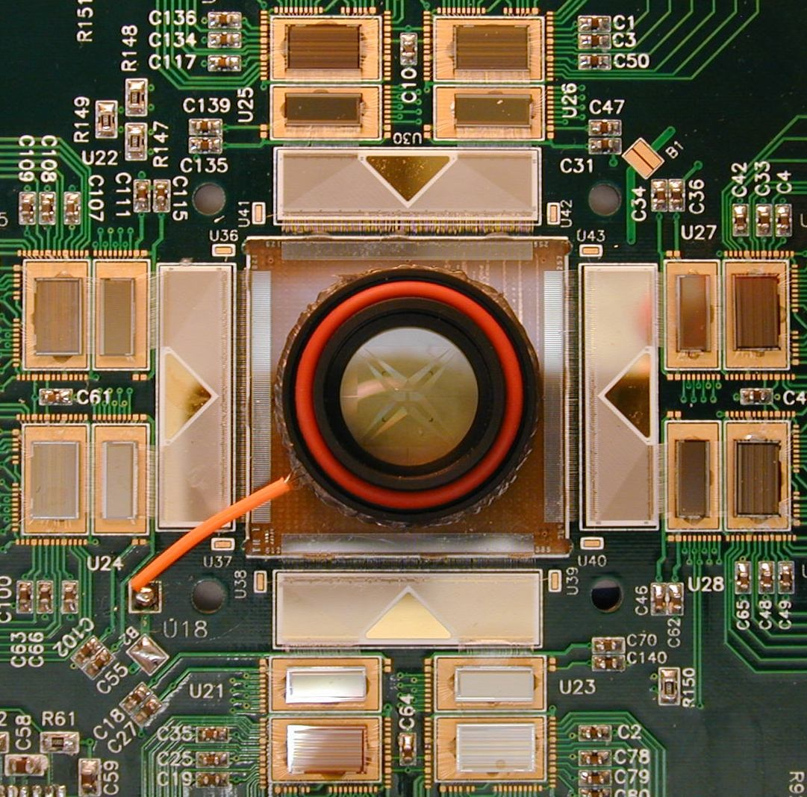
512-electrode system
9 cm

Slide 18
512-electrode system
9 cm
Litke AM, et al: What does the eye tell the brain?: Development of a system for the large-scale recording of retinal output activity. IEEE Trans Nuc Sci, 2004.

Slide 19
512-electrode system
9 cm

Slide 20
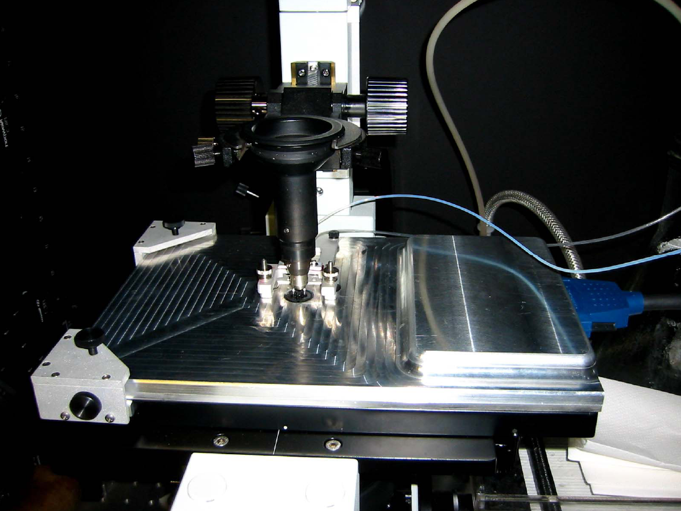
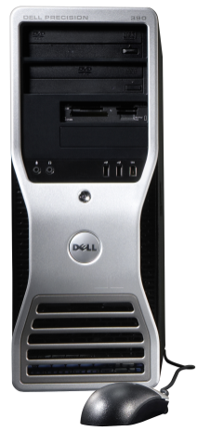
512-electrode system
512 channels
x 20 kHz
=10.24 MS/s
Litke AM, et al: What does the eye tell the brain?: Development of a system for the large-scale recording of retinal output activity. IEEE Trans Nuc Sci, 2004.

Slide 21
512-electrode system
512 channels
x 20 kHz
=10.24 MS/s
50 GB/h
Litke AM, et al: What does the eye tell the brain?: Development of a system for the large-scale recording of retinal output activity. IEEE Trans Nuc Sci, 2004.

Slide 22
Retina

Slide 23
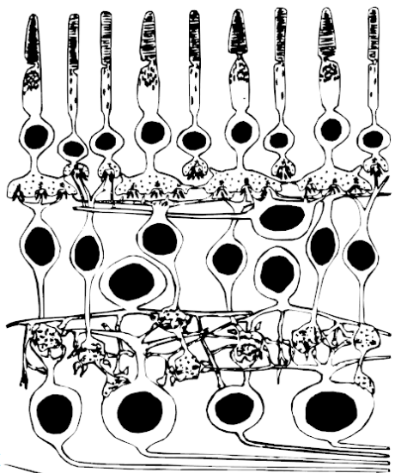
Retina

Slide 24
Retina

Slide 25
Retina

Slide 26
Retina

Slide 27
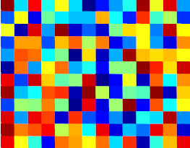
Retina

Slide 28
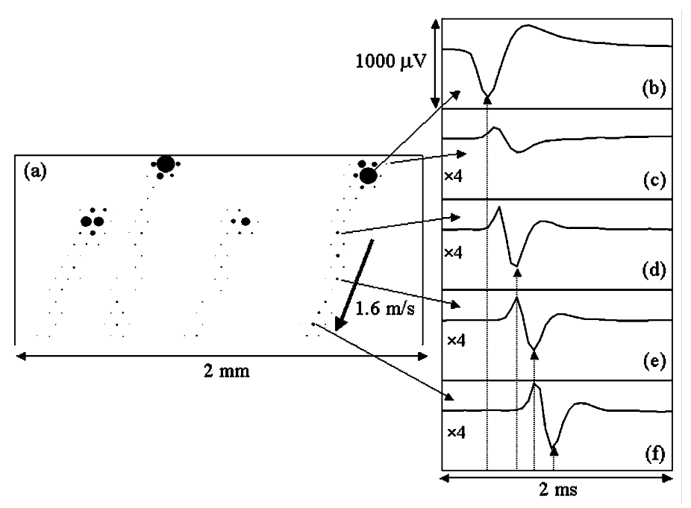
Retina

Slide 29
Retina
automated identification of signals from individual neurons:
a) visual white noise: 30 min.
b) identification based on Principal Component Analysis: 30 min. 300 – 500 cells
Litke AM, et al: What does the eye tell the brain?: Development of a system for the large-scale recording of retinal output activity. IEEE Trans Nuc Sci, 2004.

Slide 30
Retina

Slide 31
Retina

Slide 32
Retina

Slide 33
Retina
Spike Triggered Average

Slide 34
Retina

Slide 35
Retina

Slide 36
Retina

Slide 37
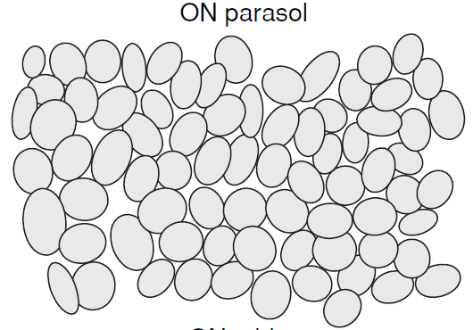
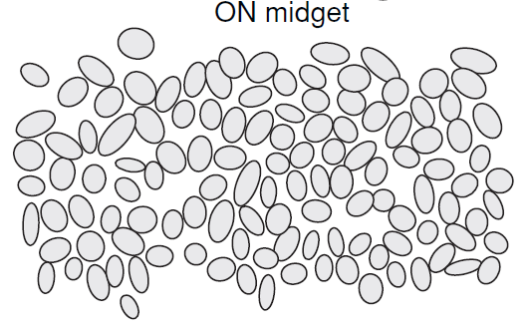
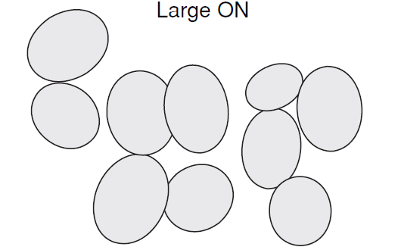
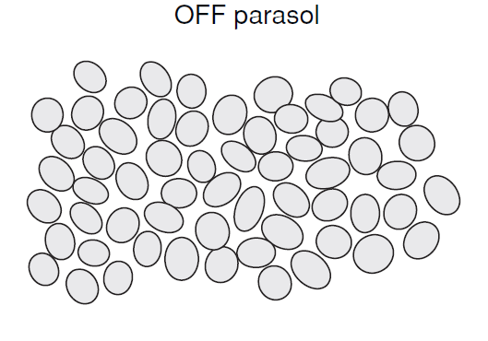
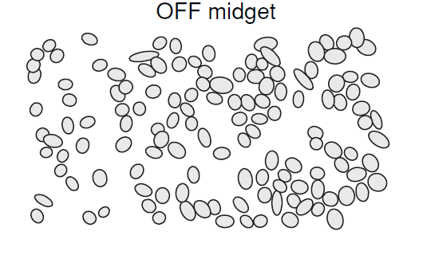
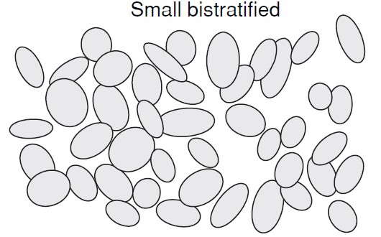
Retina
Parasol ON
Midget ON
Large ON
Parasol OFF
Midget OFF
Small bistretified
Field GD & Chichilnisky EJ: Information processing in the primate retina: circuitry and coding. Annu. Rev. Neurosci., 2007.
Pillow JW, et al: Spatio-temporal correlations and visual signalling in a complete neuronal population. Nature, 2008.

Slide 38
Cortex

Slide 39
Cortex
collaboration: John Beggs, Indiana University

Slide 40
Cortex
collaboration: John Beggs, Indiana University
300
neuron number
200
100
8
16
24
32
40
48
t [s]
Tang A, et al: A Maximum Entropy Model Applied to Spatial and Temporal Correlations from Cortical Networks In Vitro. Journal of Neuroscience, 2008.

Slide 41
Cortex
collaboration: John Beggs, Indiana University
300
neuron number
200
100
8
16
24
32
40
48
„avalanche”
t [s]
Tang A, et al: A Maximum Entropy Model Applied to Spatial and Temporal Correlations from Cortical Networks In Vitro. Journal of Neuroscience, 2008.

Slide 42
Stimulation and recording

Slide 43
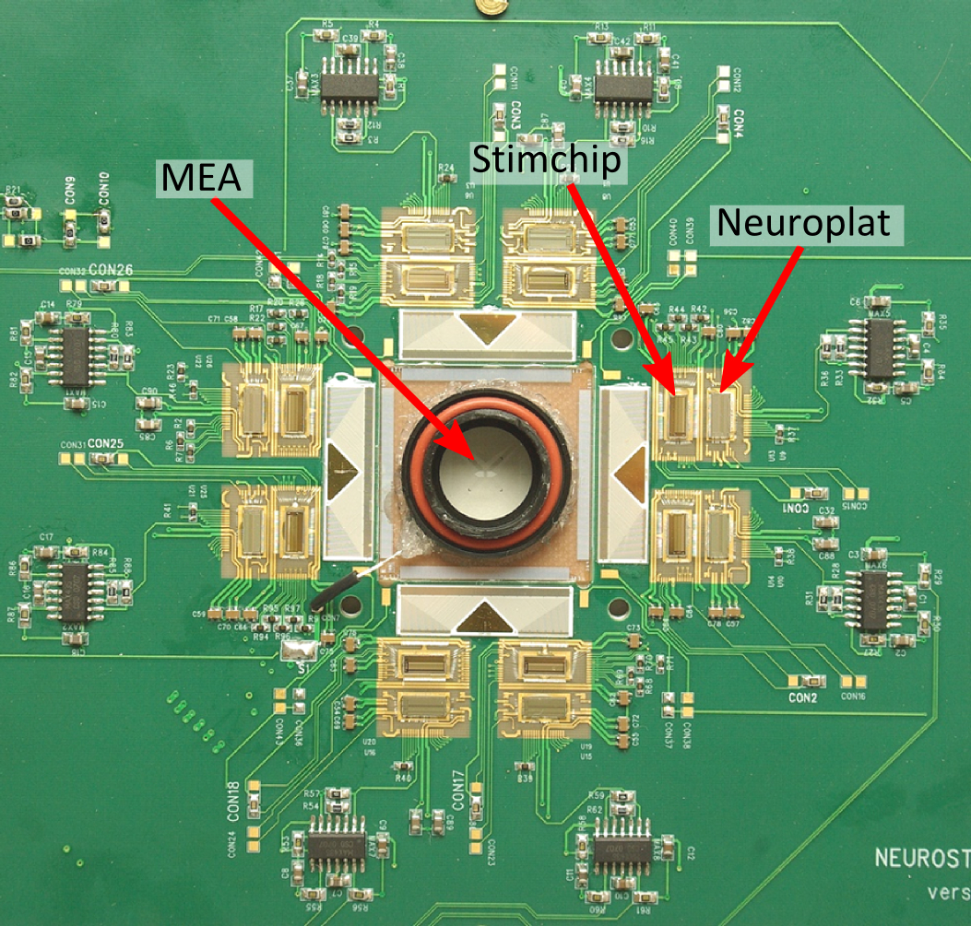
Stimulation and recording
10.24 MS/s
120 MBit/s:
512 channels/
20 kHz/12 bit
stimulation with arbitrary patterns
Hottowy P, et al: 512-electrode MEA System For Spatio-Temporal Distributed Stimulation and Recording of Neural Activity. 7th MEA Meeting, Reutlingen, 2010.

Slide 44
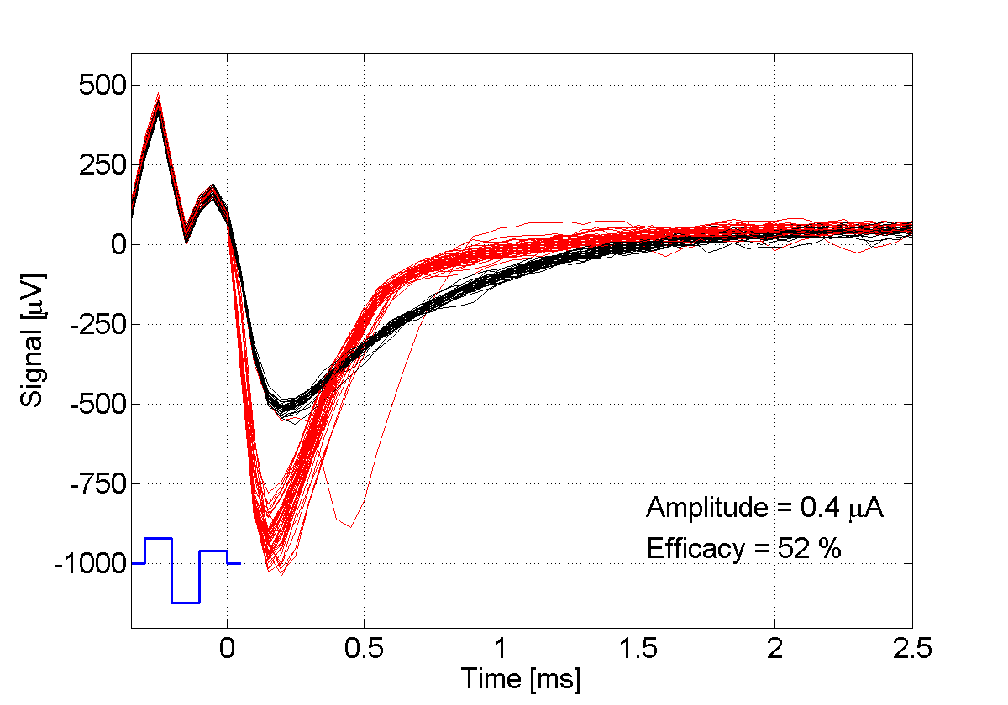
Stimulation and recording
Signal [μV]
Amplitude = 0.4 μA
Efficacy= 52%
Time [ms]

Slide 45
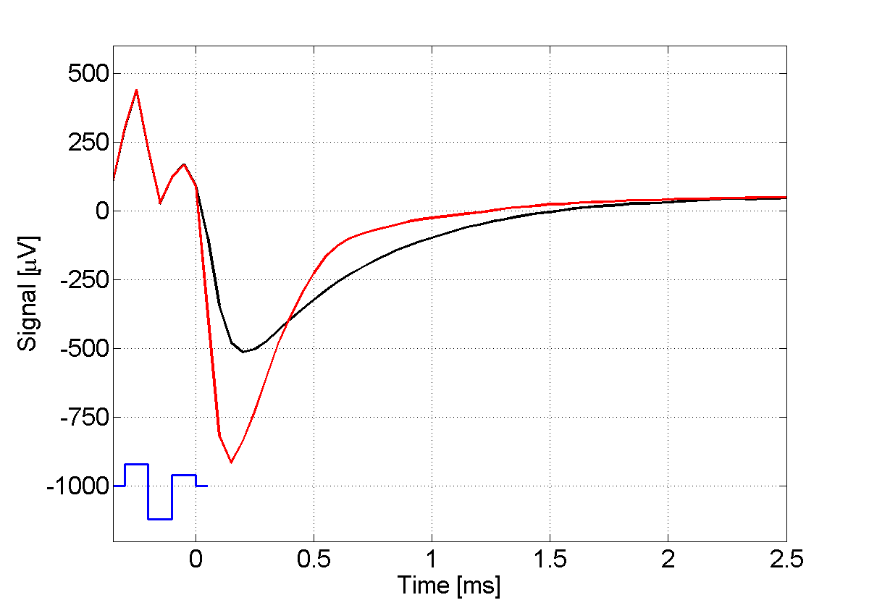
Stimulation and recording
Signal [μV]
Time [ms]

Slide 46
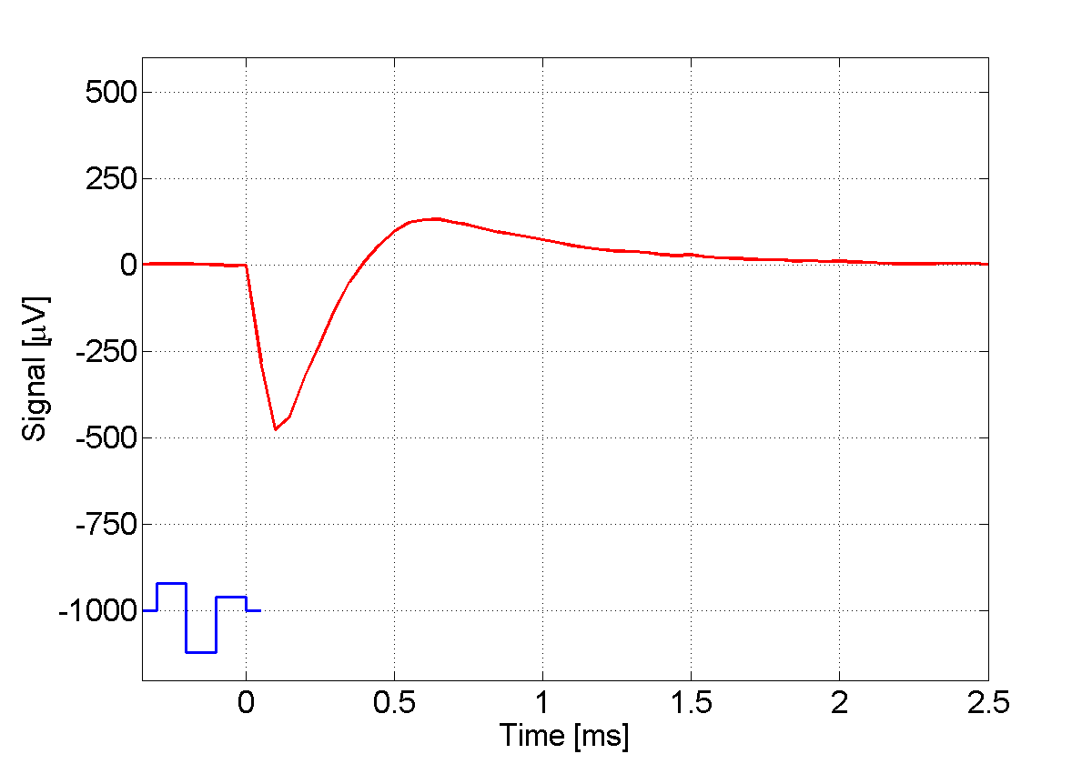
Stimulation and recording
Signal [μV]
Time [ms]

Slide 47
Stimulation and recording
Signal [μV]
Time [ms]

Slide 48
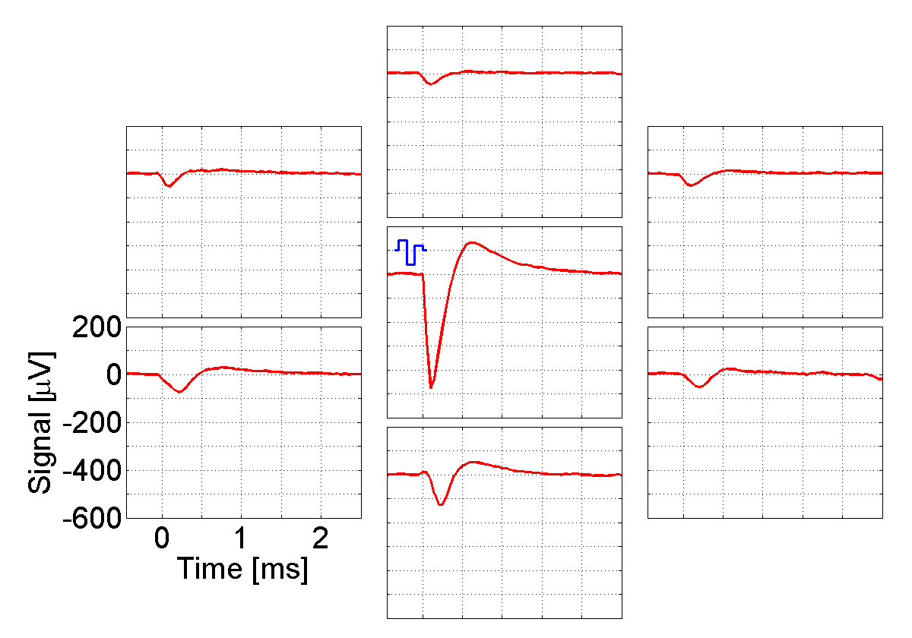
Stimulation and recording

Slide 49
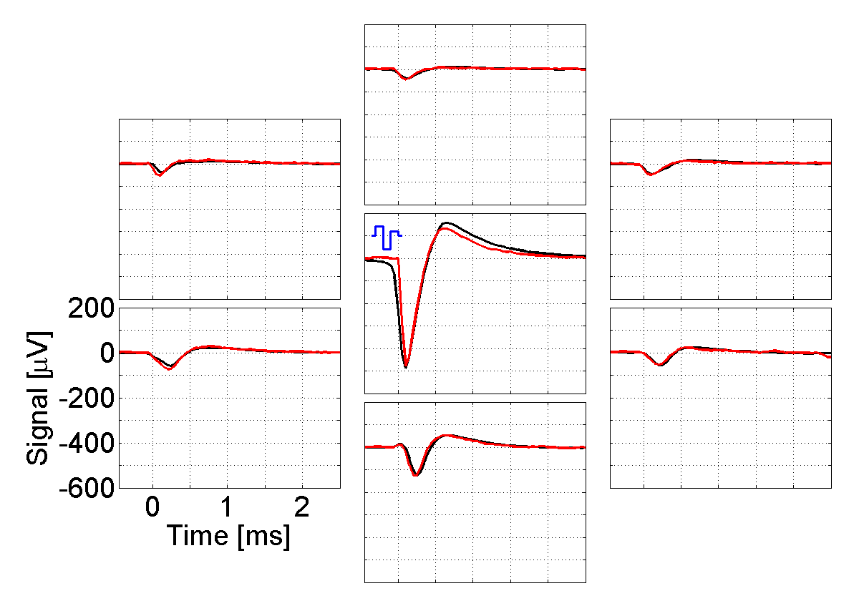
Stimulation and recording

Slide 50
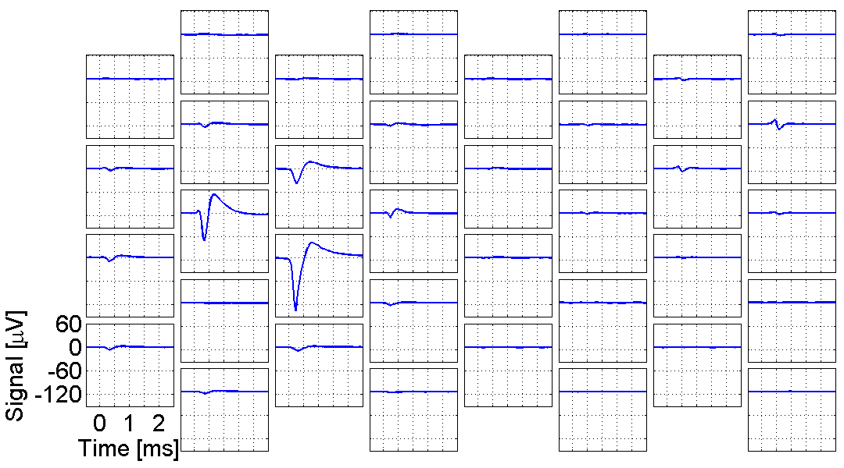
Stimulation and recording

Slide 51
Stimulation and recording

Slide 52
Stimulation and recording
0.63

Slide 53
Stimulation and recording
3.70
1.71
2.11
0.63

Slide 54
Stimulation and recording
1.30
3.70
2.31
1.71
2.11
0.63

Slide 55
In-vivo recording

Slide 56
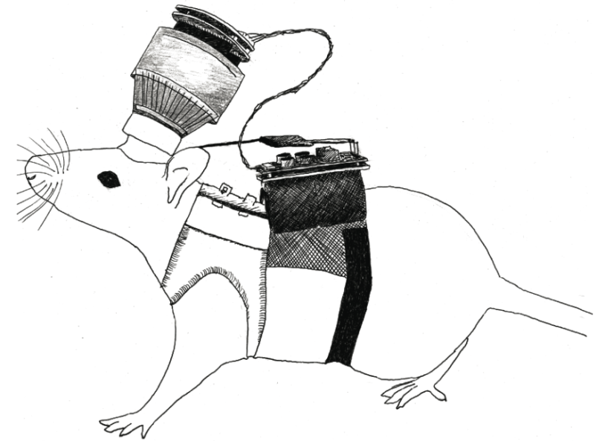
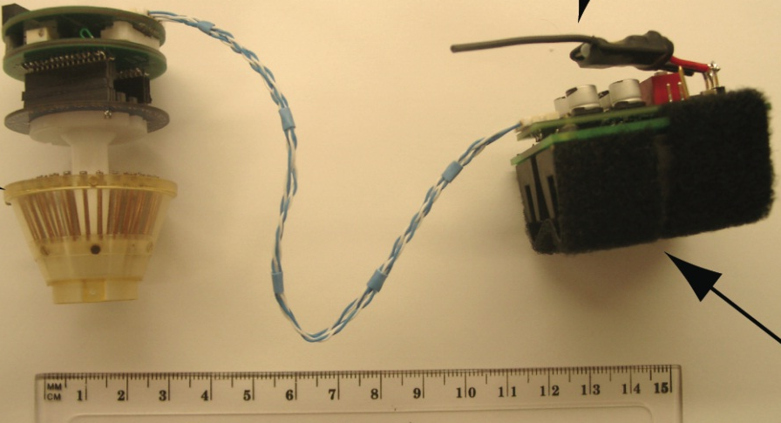
In-vivo recording
Amplification and wireless transmission of signals from 64 electrodes
Range > 60 m
Full bandwith transmission (no compression)
Total power: 600 mW
„microdrive” (17 g) (Neuralynx)
„headboard” (12 g)
transmitter(3 g)
batteries(37 g)

Slide 57
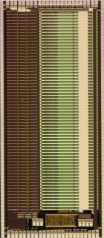
In-vivo recording
FPGA
mult.
receiver
„microdrive” (17 g) (Neuralynx)
„headboard” (12 g)
transmitter(3 g)
batteries(37 g)

Slide 58
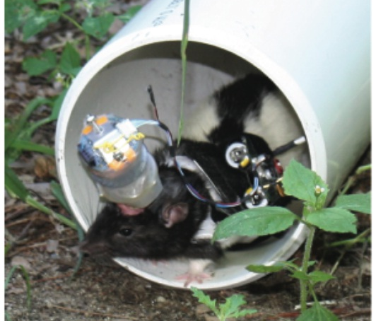
In-vivo recording
FPGA
mult.
odbiornik
spike rate [Hz]
t [ms]

Slide 59
In-vivo recording
FPGA
mult.
odbiornik
spike rate [Hz]
Szuts T, et al: Wireless Multichannel Neural Amplifier for Freely Moving Animals. Nature Neuroscience, 2011.
t [ms]

Slide 60
Plans

Slide 61
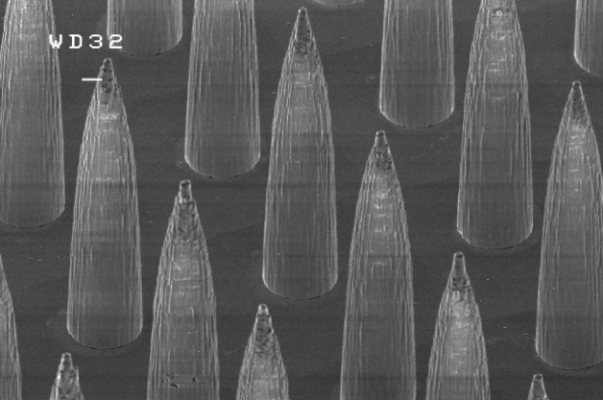
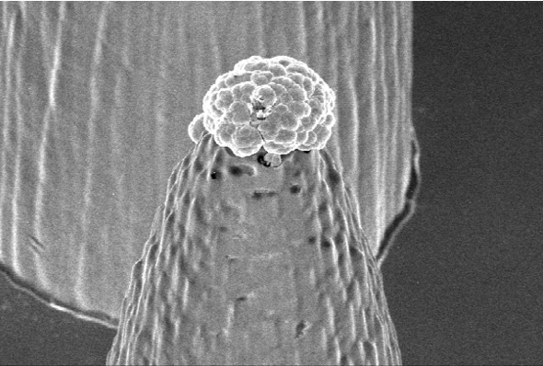
Plans
System in-vitro
Gunning DE, et al: High-density micro-needles for in vitro neural studies. 7th MEA Meeting, Reutlingen, 2010.

Slide 62
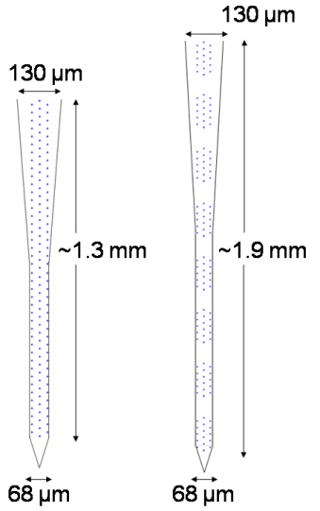
Plans
System in-vitro
System in-vivo
Gunning DE, et al: High-density micro-needles for in vitro neural studies. 7th MEA Meeting, Reutlingen, 2010.

